Slide 2
Xamarin.Forms More Productive & Beautiful Than Ever
David Ortinau
Principal Program Manager, Mobile Developer Tools

Slide 3
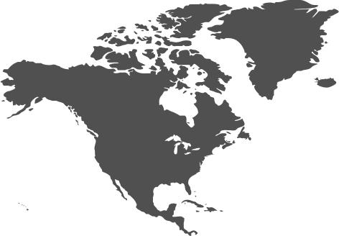
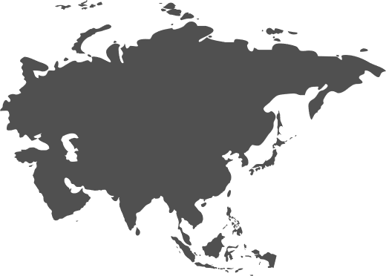




#dotnetconf
Notes:
Map – greet people watching from around the globe. How's your weather question. Then jump into demo iterating on the Weather app.
Reminder of what Motz announced.
Plug additional sessions

Slide 4
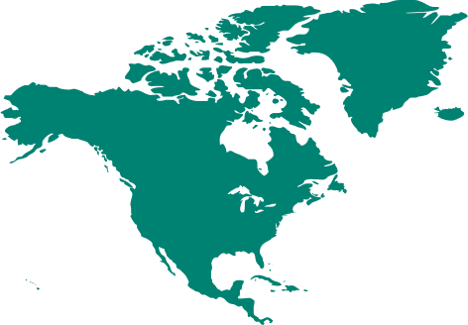
#dotnetconf
Notes:
Map – greet people watching from around the globe. How's your weather question. Then jump into demo iterating on the Weather app.
Reminder of what Motz announced.
Plug additional sessions

Slide 5

#dotnetconf
Notes:
Map – greet people watching from around the globe. How's your weather question. Then jump into demo iterating on the Weather app.
Reminder of what Motz announced.
Plug additional sessions

Slide 6

#dotnetconf
Notes:
Map – greet people watching from around the globe. How's your weather question. Then jump into demo iterating on the Weather app.
Reminder of what Motz announced.
Plug additional sessions

Slide 7

#dotnetconf
Notes:
Map – greet people watching from around the globe. How's your weather question. Then jump into demo iterating on the Weather app.
Reminder of what Motz announced.
Plug additional sessions

Slide 8
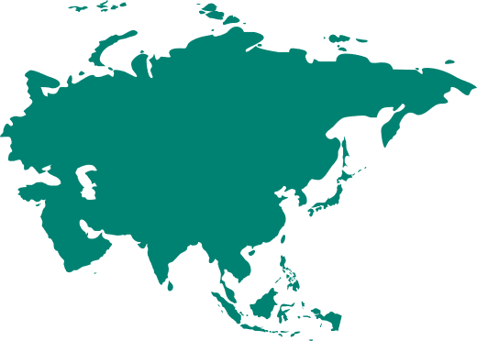
#dotnetconf
Notes:
Map – greet people watching from around the globe. How's your weather question. Then jump into demo iterating on the Weather app.
Reminder of what Motz announced.
Plug additional sessions

Slide 9

#dotnetconf
Notes:
Map – greet people watching from around the globe. How's your weather question. Then jump into demo iterating on the Weather app.
Reminder of what Motz announced.
Plug additional sessions

Slide 10
How's the weather?
Demo
Notes:
Glenn "Because you don't need any other weather than Redmond" O-really?

Slide 11
Announcements
XAML Hot Reload
http://aka.ms/xamlhotreload
Hot Restart – Private Preview TODAY
https://aka.ms/xamarin-hotrestart
Latest SDKS
Xamarin.Forms 4.3.0-pre2
Xamarin.iOS 13
Xamarin.Android 10

Slide 12
More Xamarin
Day 2
Visual Studio for Mac Reborn: New Editors and New Experiences Cody Beyer 09:00 (PDT) | 16:00 (UTC)
Build Amazing Cloud Connected Apps With Xamarin, Azure, and App Center Matthew Soucoup 15:30 (PDT) | 22:30 (UTC)
Building Modern Android Applications with Xamarin Jon Douglas 18:00 (PDT) | 01:00 (UTC)
Day 3
Boosting your Xamarin Development Productivity Maddy Leger 11:00 (PDT) | 18:00 (UTC)
Mixed Reality with Xamarin and Azure Spatial Anchors Sweekriti Satpathy 16:00 (PDT) | 23:00 (UTC)

Slide 13
Beautiful UI Found Here
Notes:
Big thank you to contributors. Show growth. Gifts on the way.

Slide 14
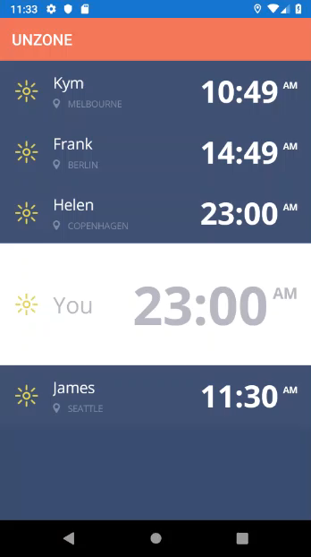
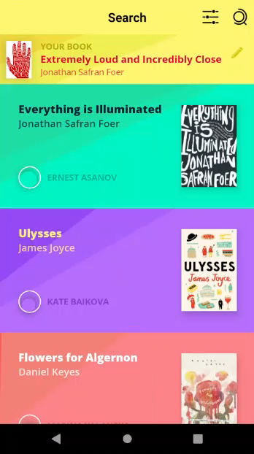
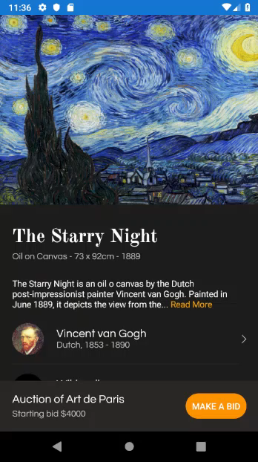
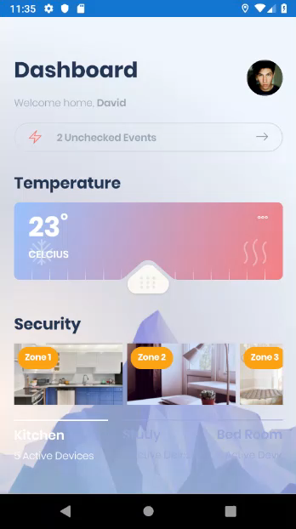
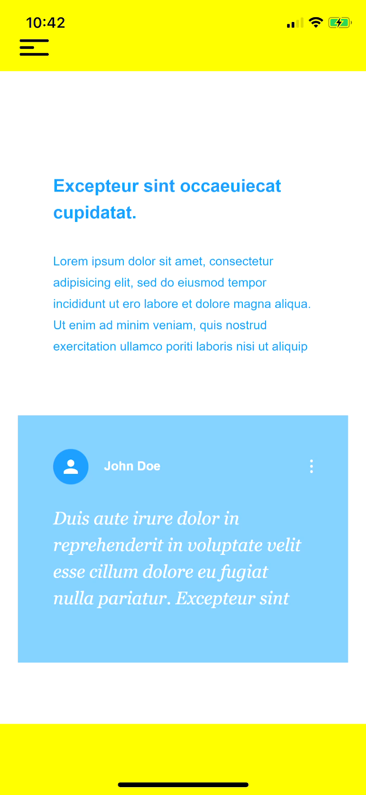
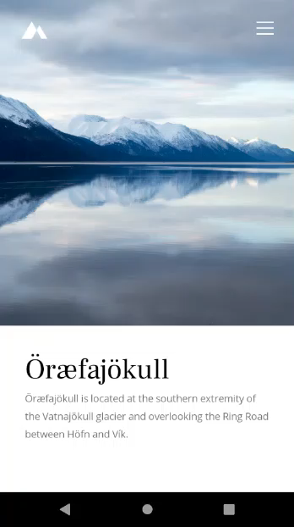
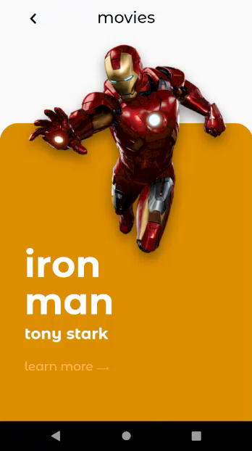
Kym Phillpotts
https://www.twitch.tv/kymphillpotts
Notes:
Gallery of all his UI challenges

Slide 15
Kym Phillpotts
https://www.twitch.tv/kymphillpotts
Notes:
Gallery of all his UI challenges

Slide 16
How Xamarin Delivers the Awesome
Notes:
Big thank you to contributors. Show growth. Gifts on the way.

Slide 17

.NET
100% Platforms APIs
100% Native Experience
90%+ Shared Code
All with .NET
Shared Native UI
Shared logic

Slide 18
✓ Always up-to-date
Same-day support:
iOS 5
iOS 6
iOS 7
iOS 8
iOS 9
iOS 10
iOS 11
iOS 12
iOS 13
Support for:
iOS Extensions
Apple Watch
Apple TV
Android Wear
Amazon Fire TV
and more
Notes:
To top it all off, Xamarin is on top of all the latest OS updates and additional platforms.

Slide 19
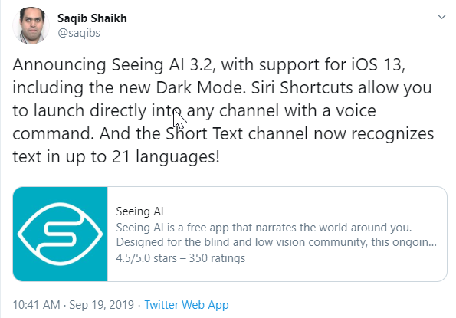

Slide 20
Mature (and growing!) Control Toolkit
ActivityIndicator
BoxView
Button
DatePicker
Editor
Entry
Image
Label
ListView
Map
OpenGLView
Picker
ProgressBar
SearchBar
Slider
Stepper
TableView
TimePicker
WebView
EntryCell
ImageCell
SwitchCell
TextCell
ViewCell
ImageButton
CarouselView
CollectionView
RefreshView
CheckBox
…
Notes:
Then there is the growing list of controls that you can use in your app. Each have several properties and events that you can optimize for your app.

Slide 21


Xamarin & Xamarin.Forms ecosystem
Notes:
If there is something not in the box, don’t worry as there is a huge ecosystem around Xamarin and Xamarin.Forms apps.

Slide 22


















Massive Collection of Libraries & Tools
Cognitive
Services
Azure Active
Directory B2C
Zxing
Barcode
Scanning
Akavache
Zeplin
GrialKit
Notes:
First is libraries, essentially giving you anything that you need.

Slide 23




























Xamarin
Loved by developers, trusted by enterprise
Notes:
In fact there are tons of companies that entrust Xamarin and .NET today.
These companies leverage Xamarin and .NET across all verticals and all different types of platforms.

Slide 24
Faithful Contributors
Notes:
Big thank you to contributors. Show growth. Gifts on the way.

Slide 25




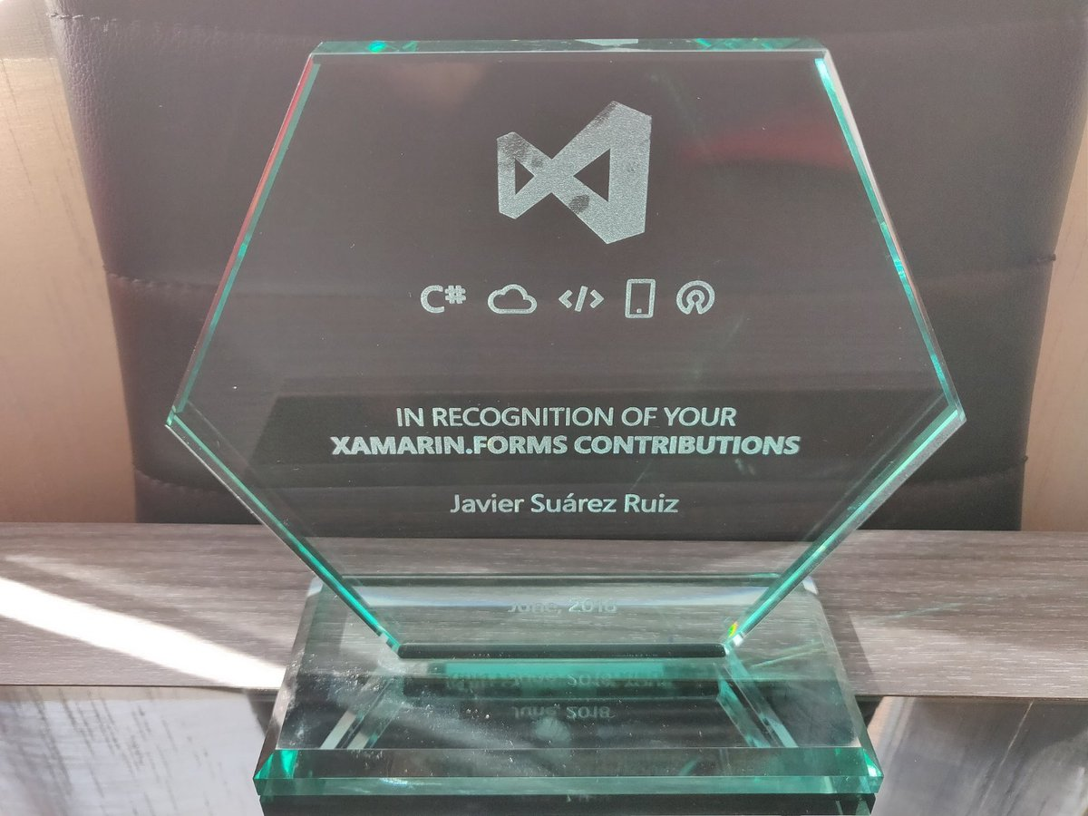




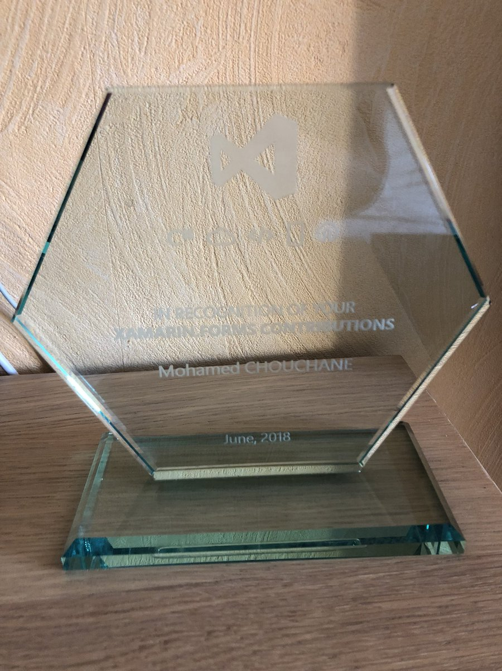

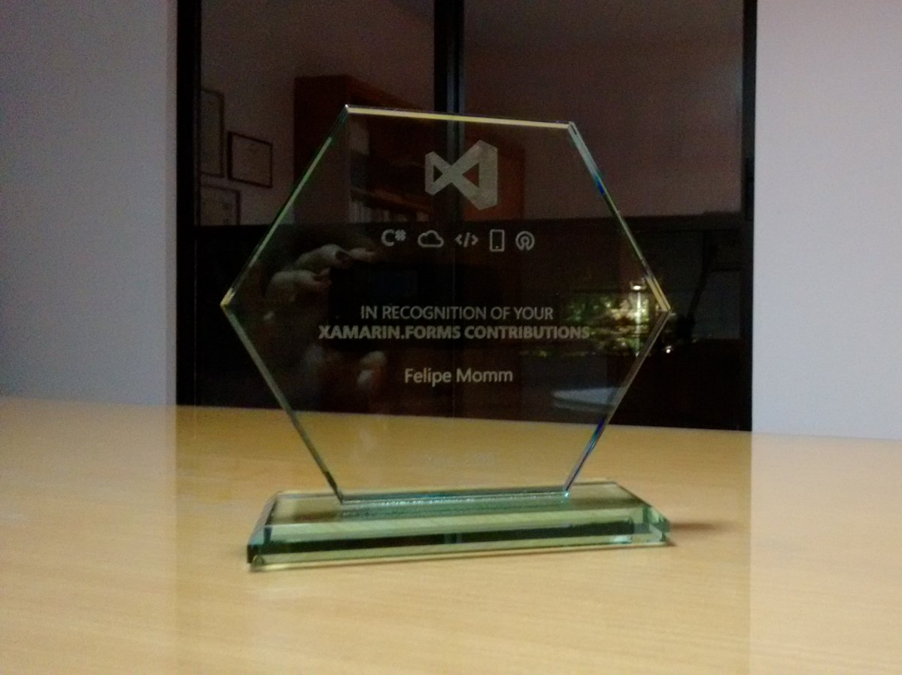

THANK YOU!
Notes:
Last year. This year

Slide 26
Amazing Community
Notes:
Blogs and community challengs

Slide 27

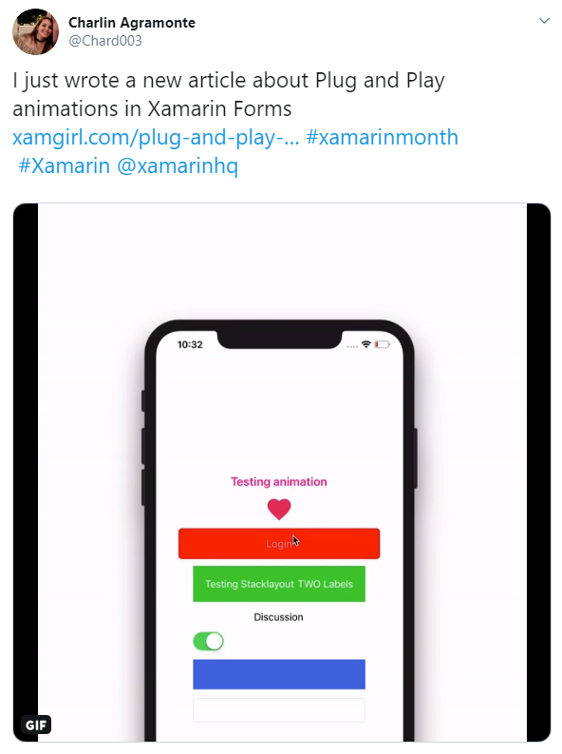
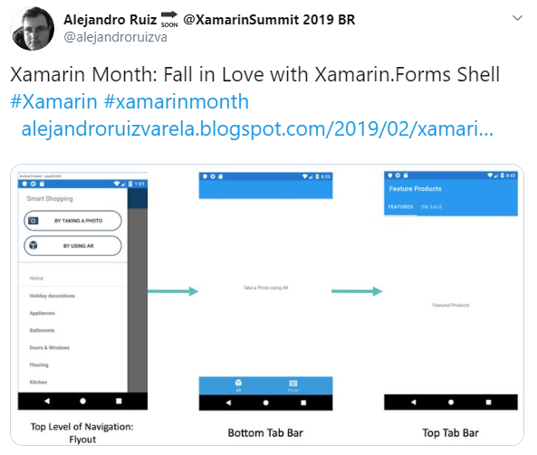
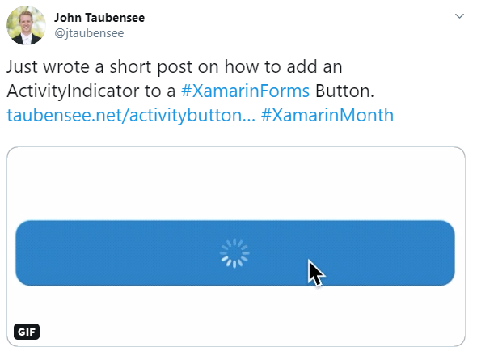
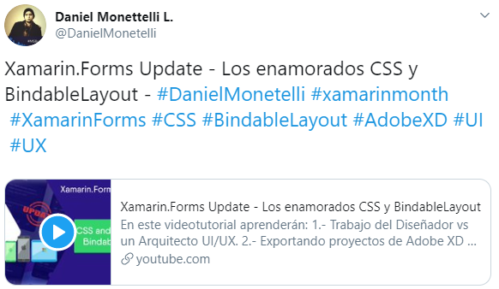
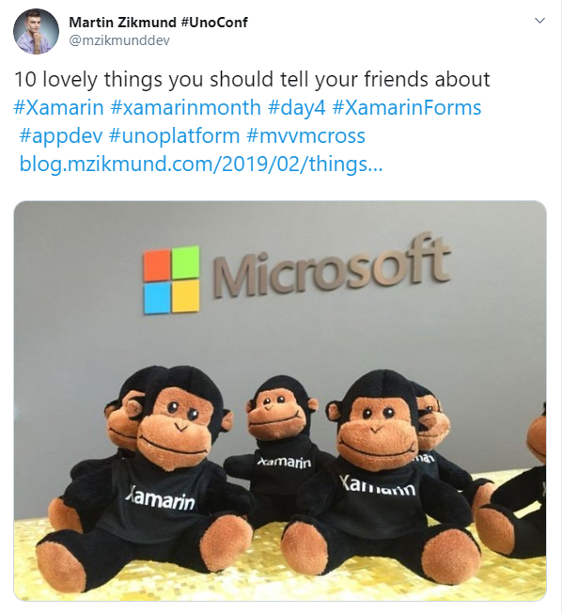
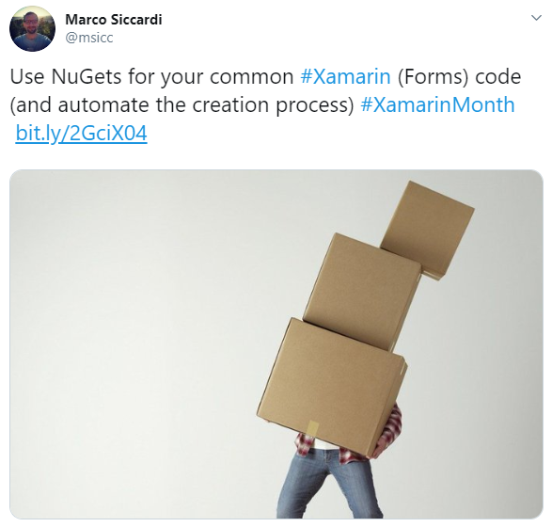
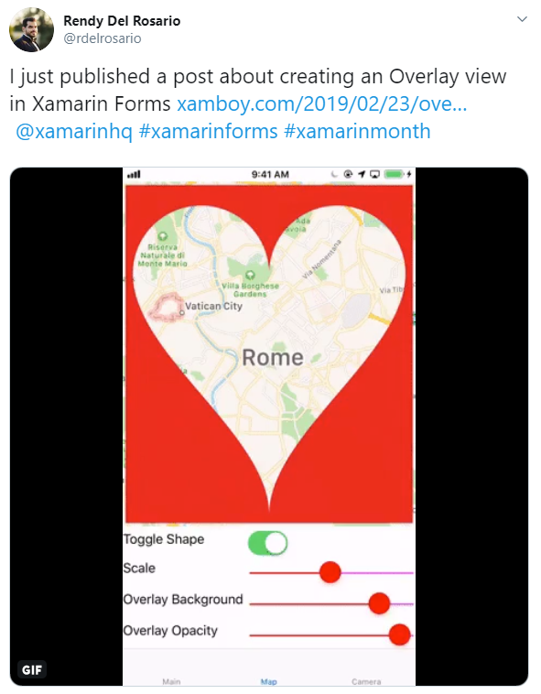
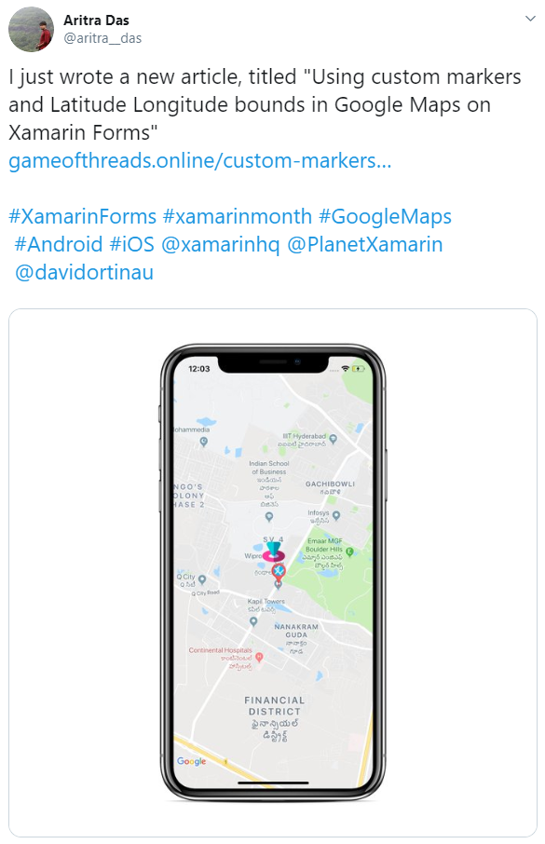
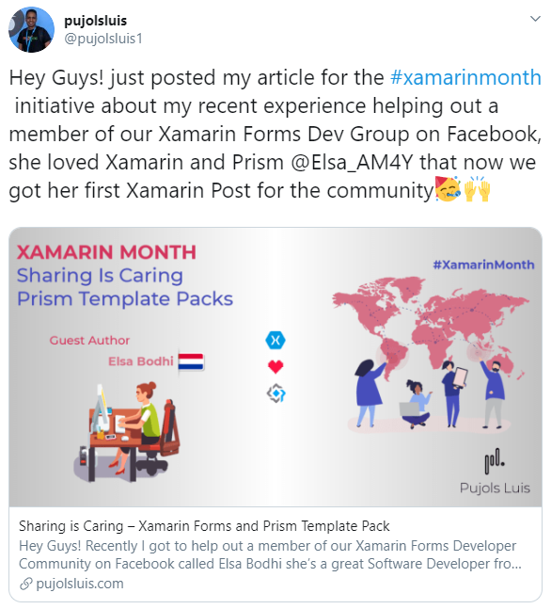
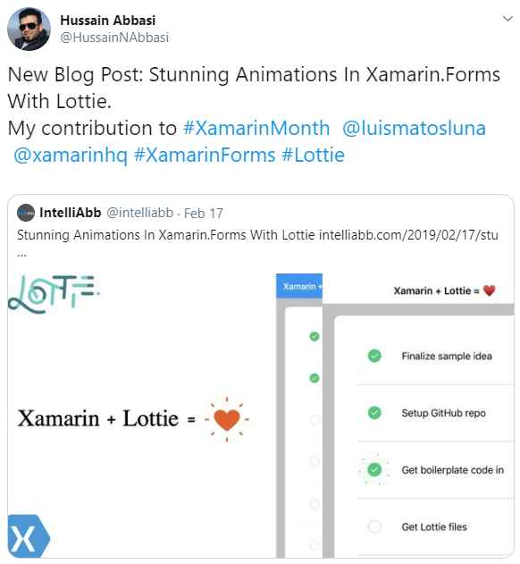
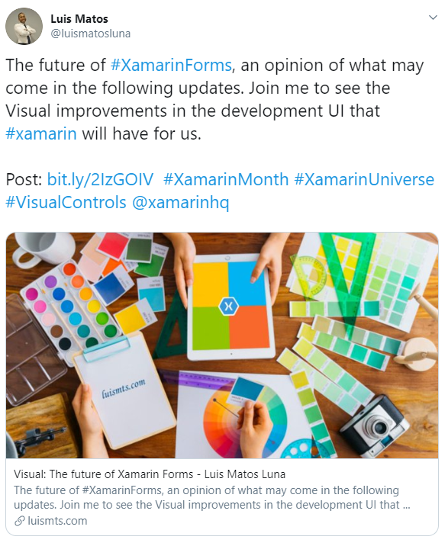
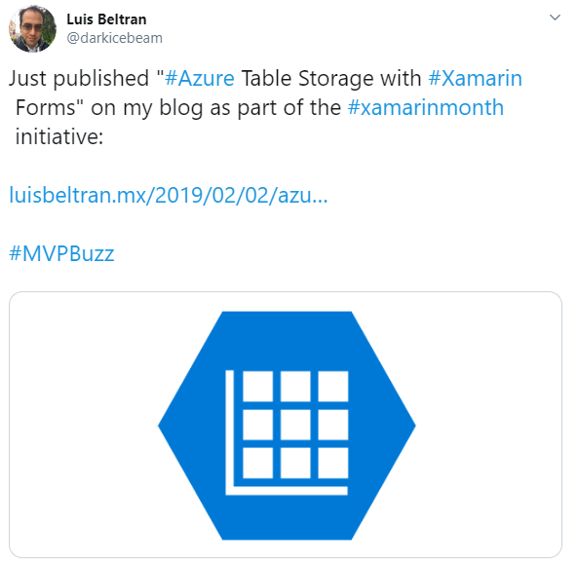
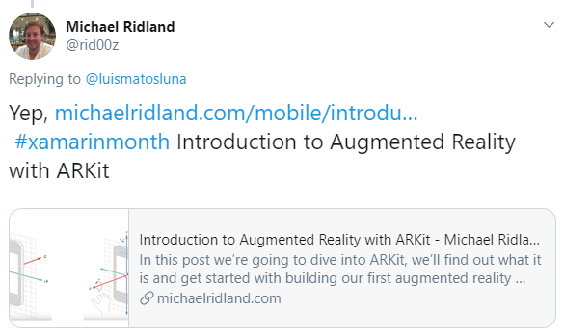

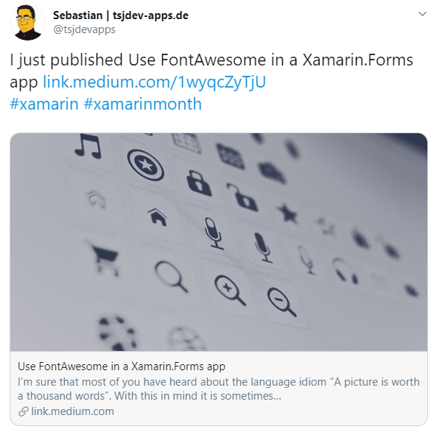
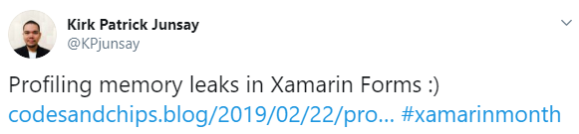

Slide 28
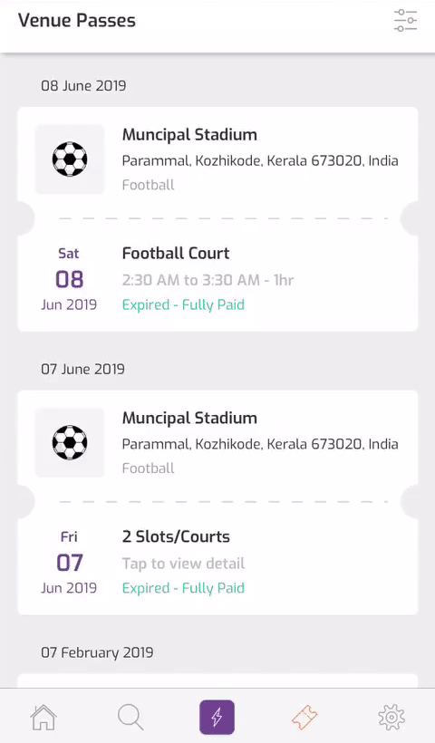
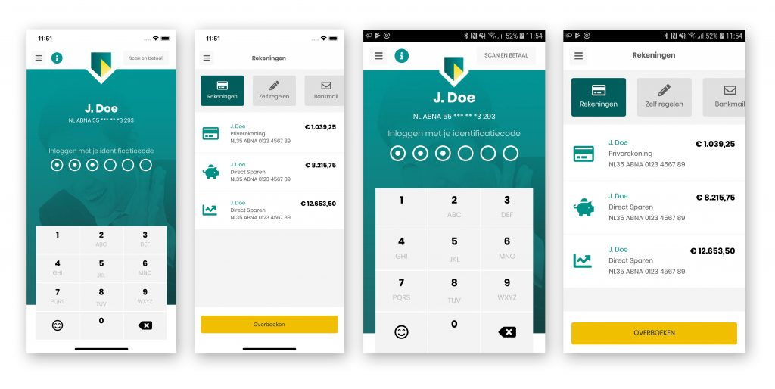

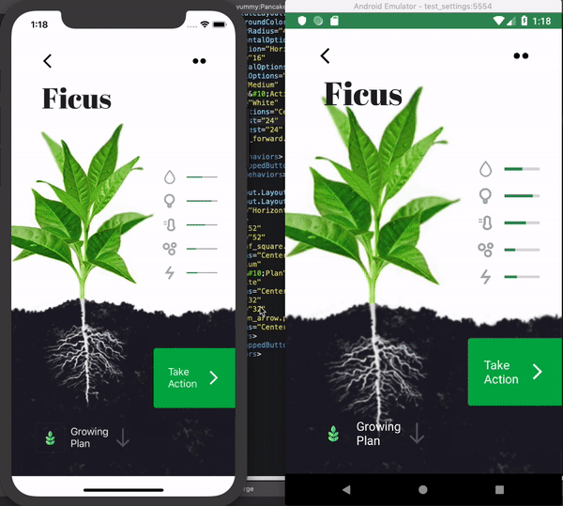
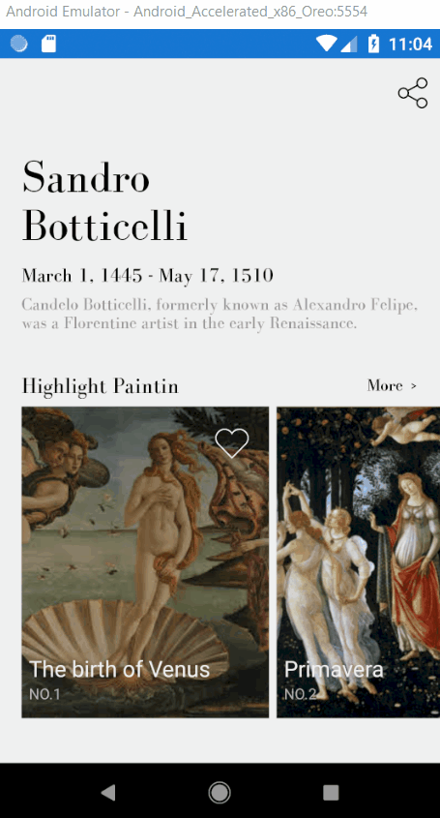
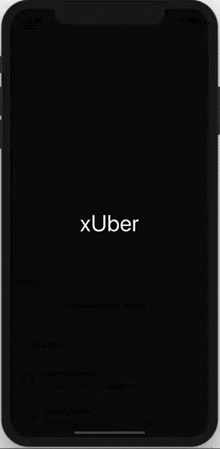
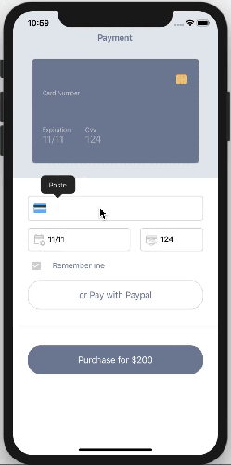
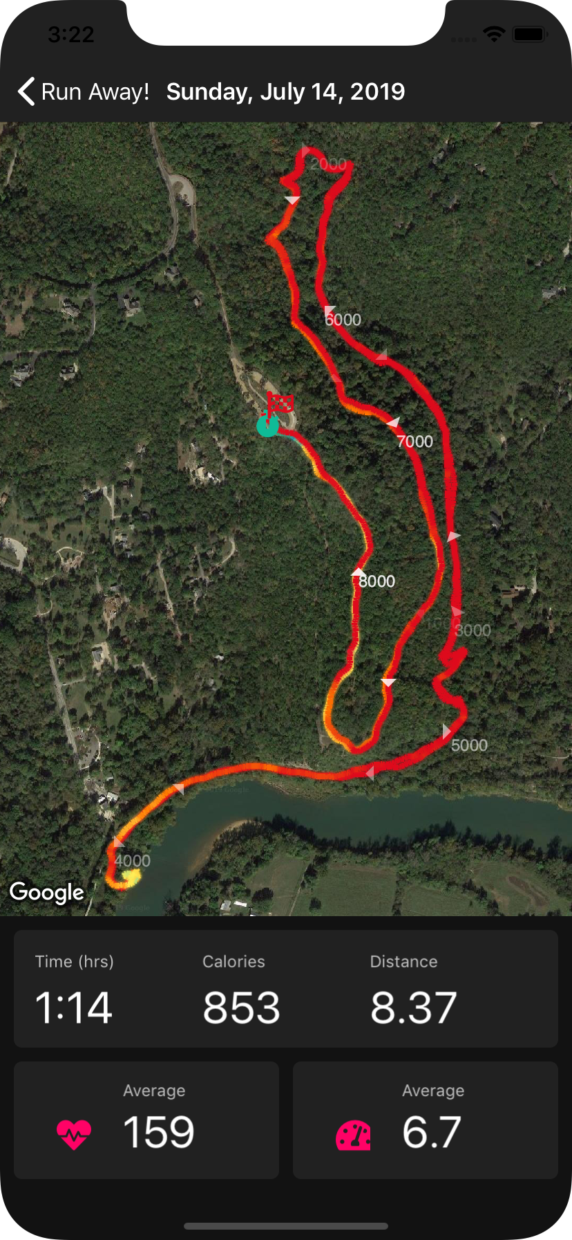
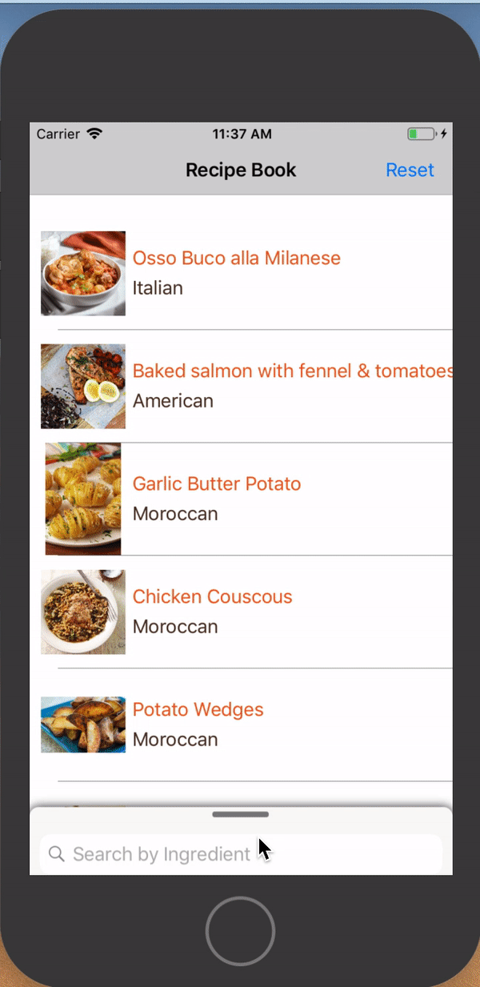
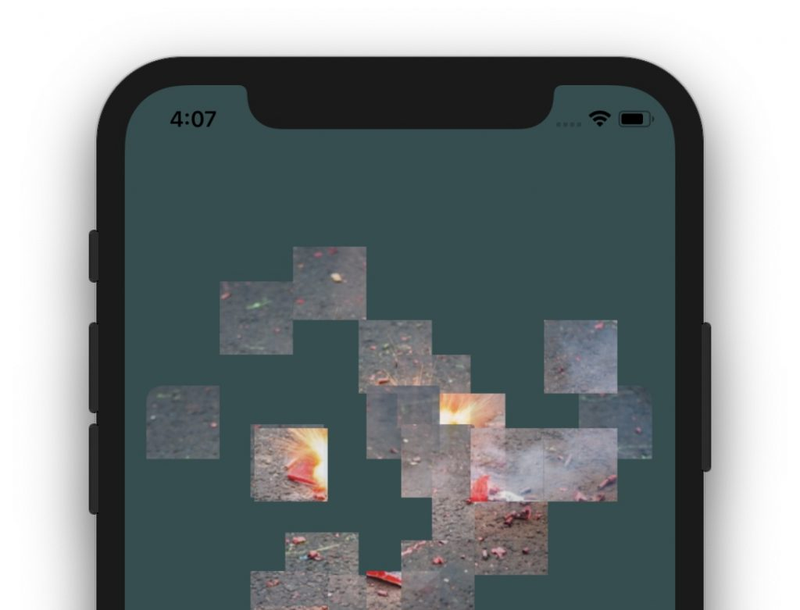
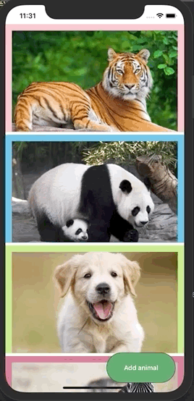
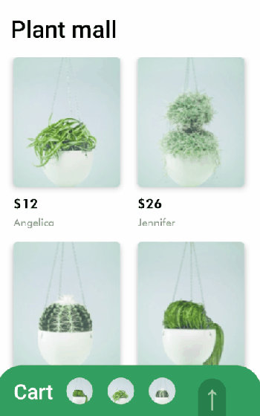
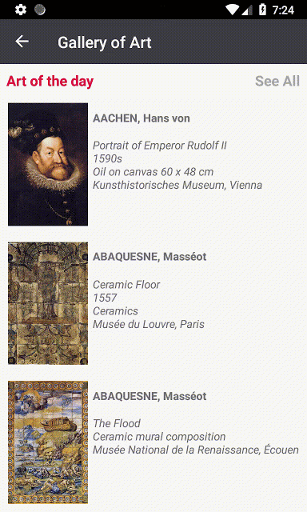
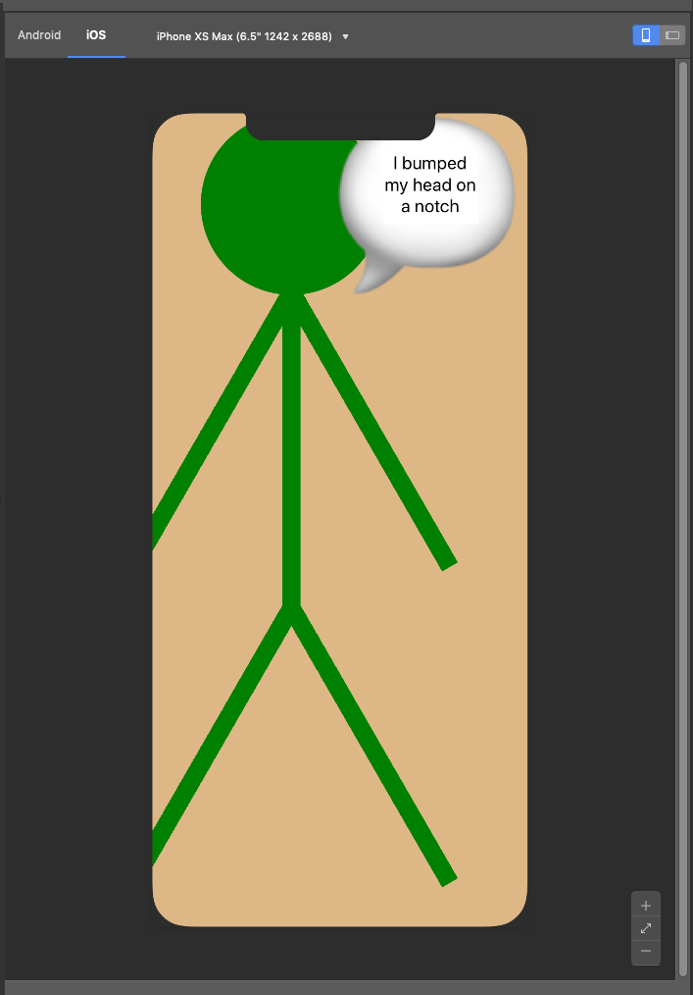
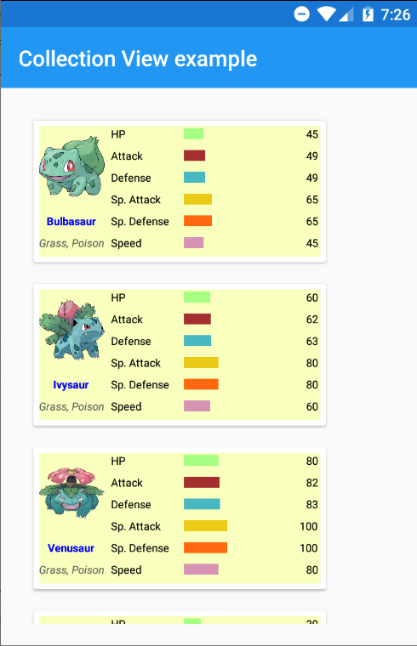

Slide 29
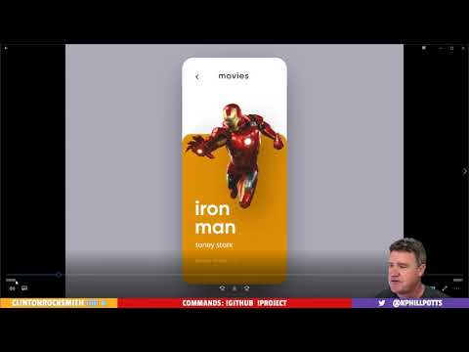
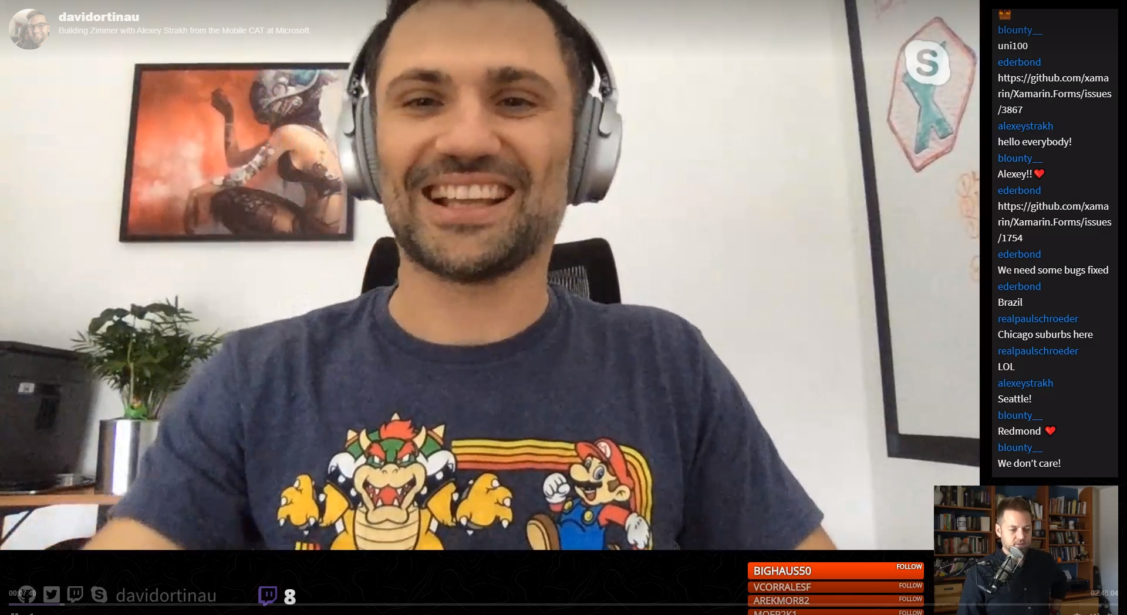

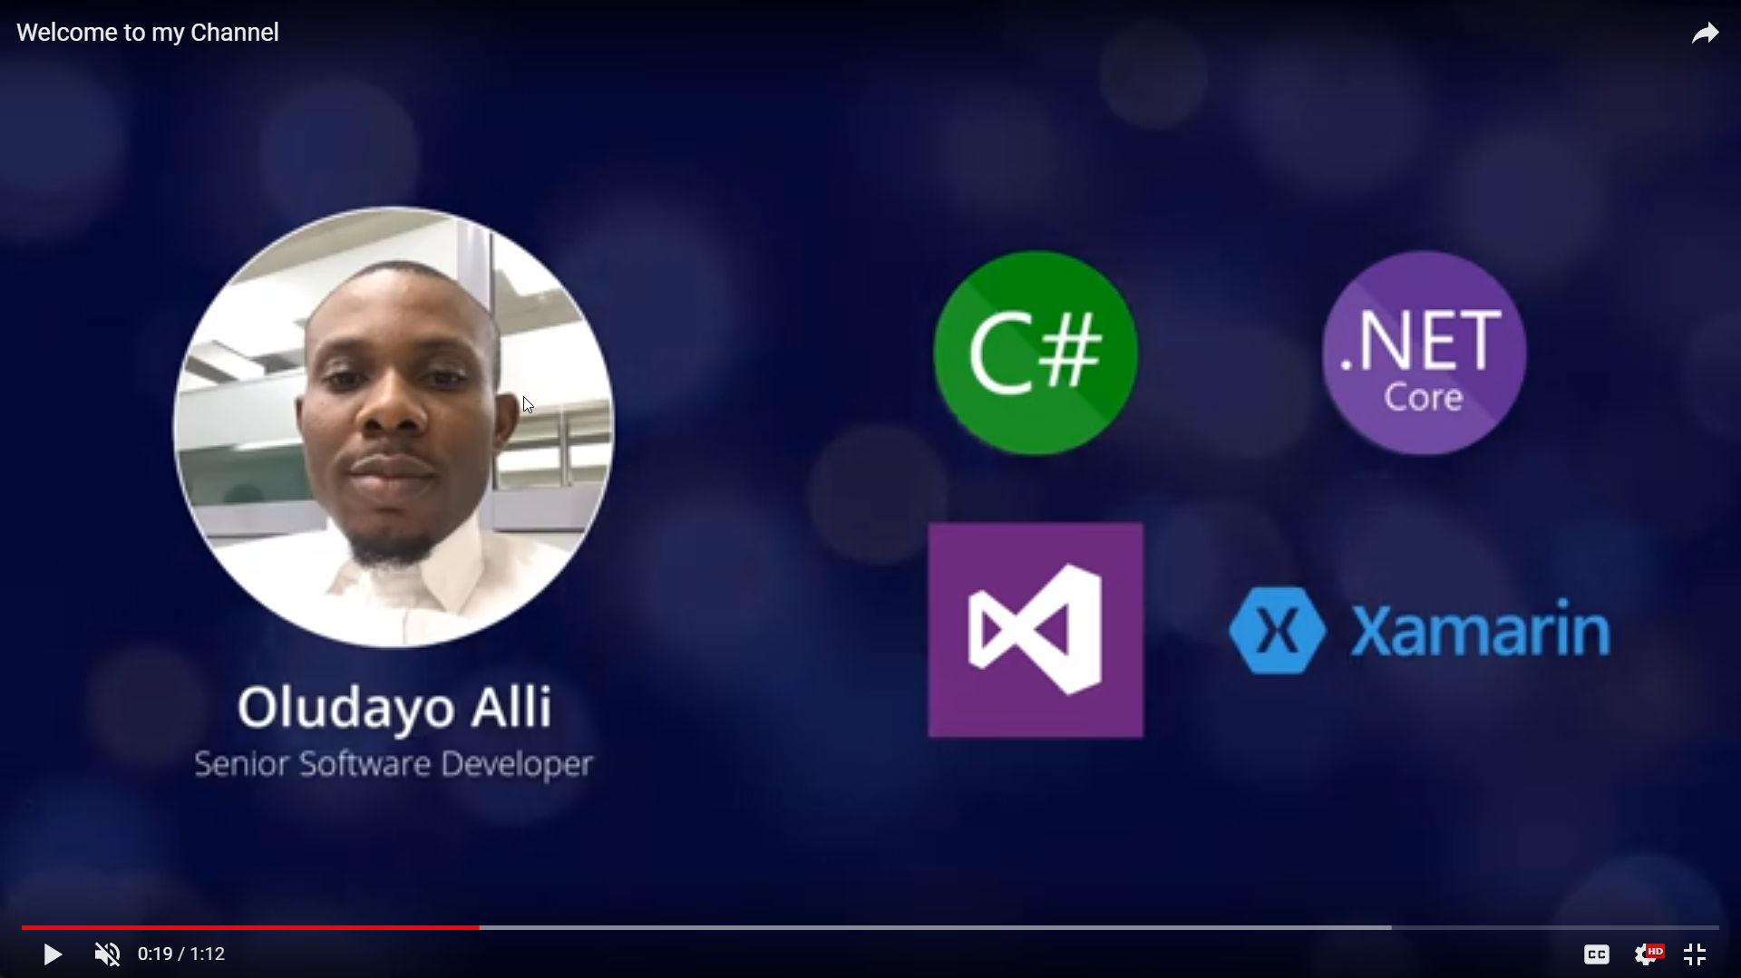
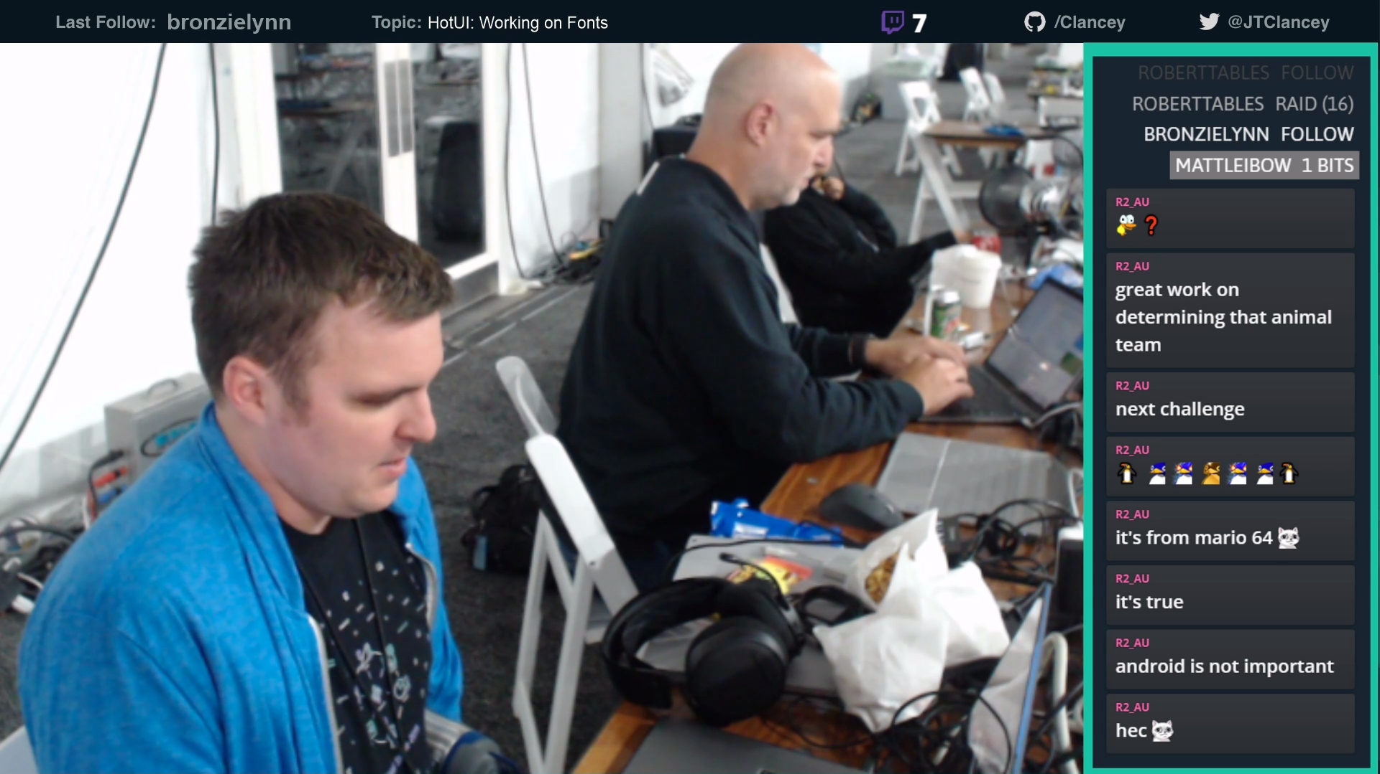

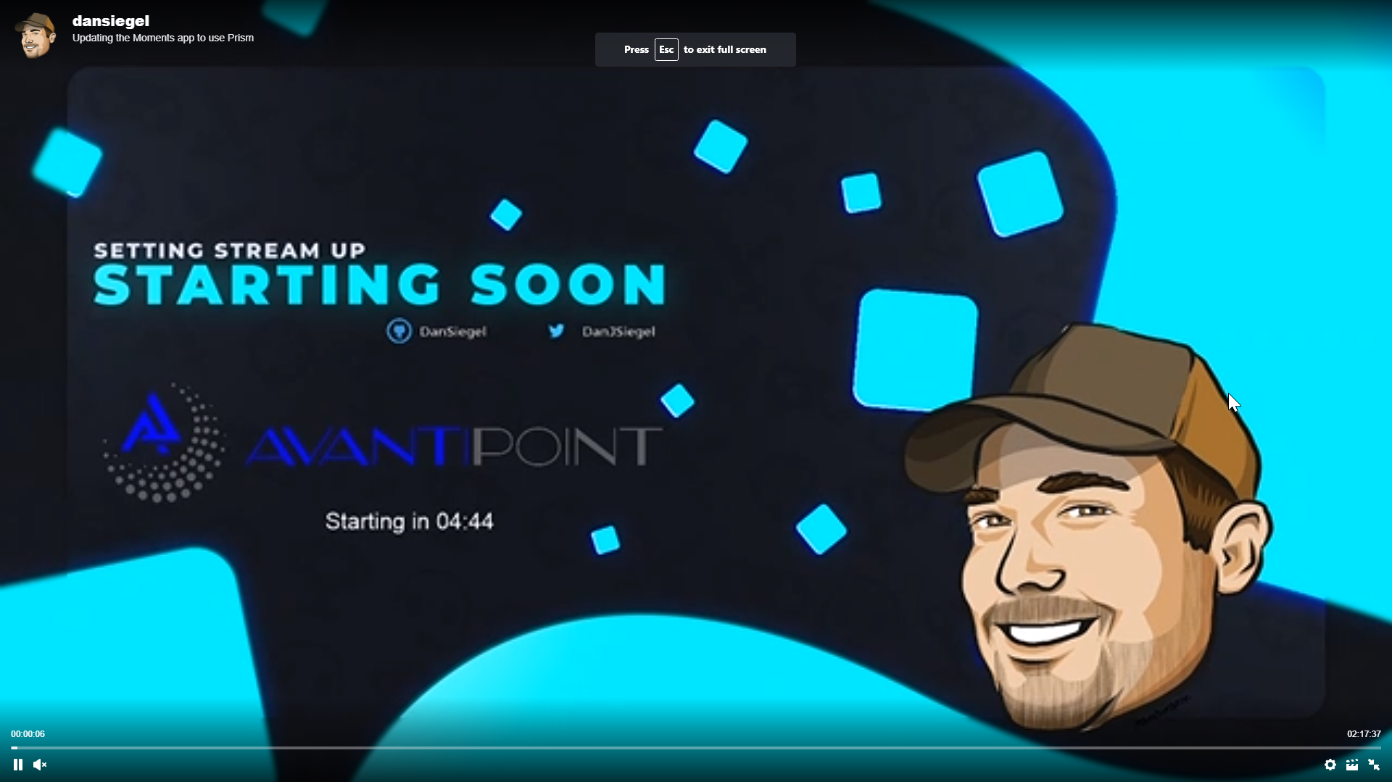
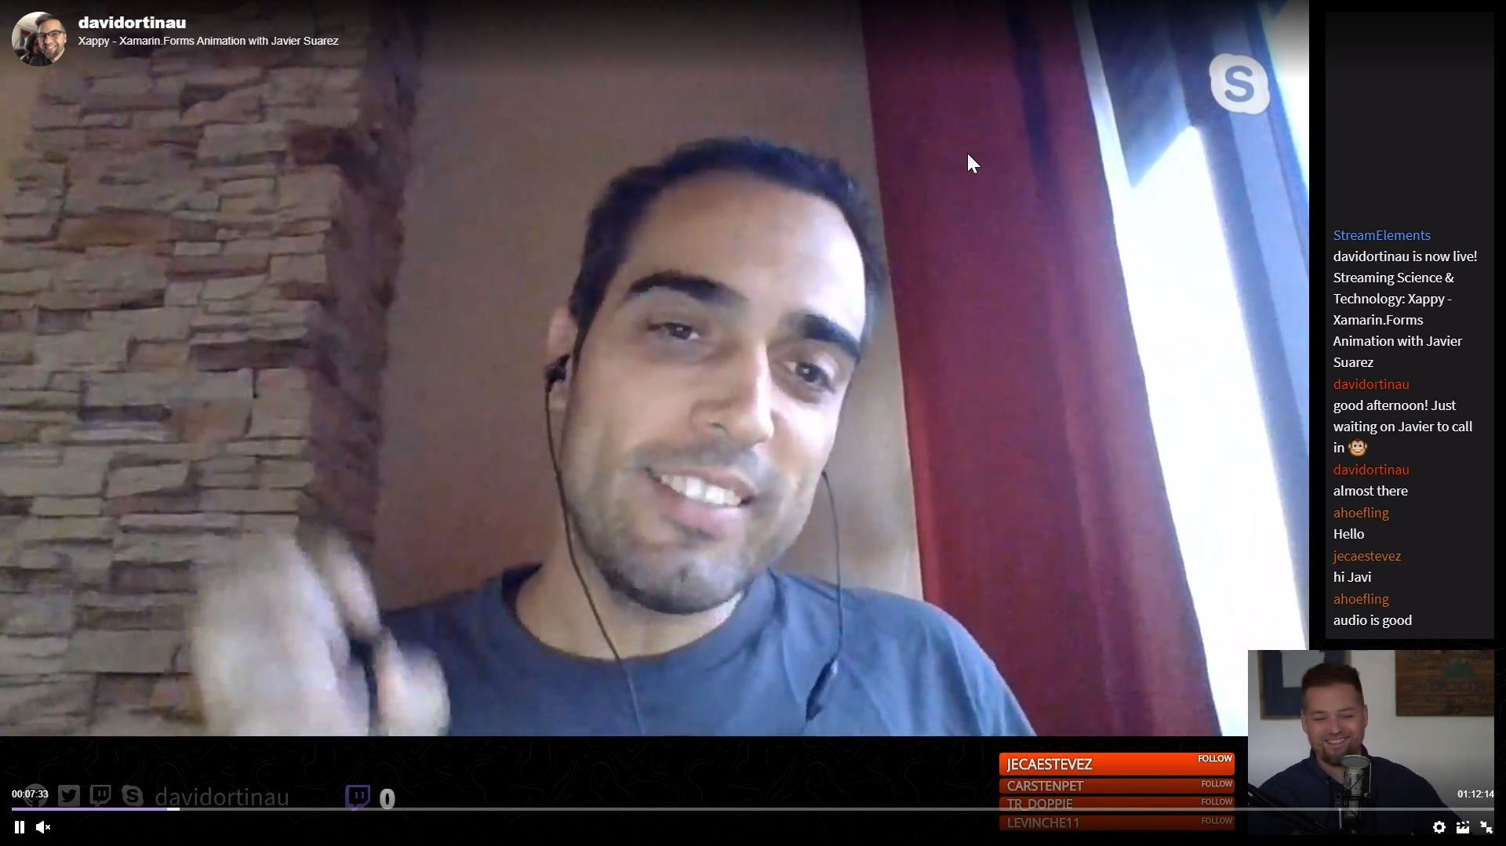










aka.ms/xamstreamers
Notes:
Collage of streamers streaming. Put a list up on aka.ms/xamstreamers
Motz
Clancey
Me
Kym
Glenn
Gerald
Javier
Shane
https://www.youtube.com/channel/UCVwwehJC74qBhMhwFWJkwEQ
https://www.youtube.com/channel/UCBKLE3rLU0CJebTBJ_N4ajQ Xamarin Guy
https://www.twitch.tv/codingwithluce
https://www.youtube.com/c/monkeynights
https://www.pscp.tv/ionixjunior

Slide 30
Xamarin.Forms
Notes:
Blogs and community challengs

Slide 31



Shell
Notes:
It all starts here with the quickest and easiest way to setup your application.

Slide 32
<Shell>
<FlyoutItem
Title="Style Guide"
Icon="Compass.png">
<ShellContent
ContentTemplate="{DataTemplate p:StyleGuidePage}"/>
</FlyoutItem>
</Shell>
Shell
Notes:
It all starts here with the quickest and easiest way to setup your application.

Slide 33
<Shell>
<TabBar>
<Tab
Title="Styles"
Icon="Compass.png">
<ShellContent
ContentTemplate="{DataTemplate
p:StyleGuidePage}"/>
</Tab>
</TabBar>
</Shell>
Shell
Notes:
It all starts here with the quickest and easiest way to setup your application.

Slide 34
<Shell>
<TabBar>
<Tab
Title="Style Guide"
Icon="Compass.png">
<ShellContent
Title="Colors"
ContentTemplate="{DataTemplate p:ColorsPage}"/>
<ShellContent
Title="Text"
ContentTemplate="{DataTemplate p:TextPage}"/>
</Tab>
</TabBar>
</Shell>
Shell
Notes:
It all starts here with the quickest and easiest way to setup your application.

Slide 35
CityListPage
CityDetailPage
Shell.Current
.GoToAsync($"detail?id={city.id}");
Shell Navigation Service
Notes:
It all starts here with the quickest and easiest way to setup your application.

Slide 36
CityListPage
CityDetailPage
[QueryProperty("CityId", "id")]
public partial class CityDetailPage : ContentPage
{
public CityDetailPage()
{
InitializeComponent();
}
public string CityId
{
set
{
// do something with the Id
}
}
}
Shell Navigation Service
Notes:
It all starts here with the quickest and easiest way to setup your application.

Slide 37

Sets of renderers
Adhering to a specific design system
Beginning with Material Design
ActivityIndicator
Button
Editor
Entry
Frame
Picker
ProgressBar
Slider
Stepper
<Button Text="Consistent Design"
Visual="Material"/>
Visual
Notes:
Looking for consistent UI but retaining platform idioms? Material controls for Visual.

Slide 38






CollectionView
Notes:
Animations of a bunch of layouts
Basic list vertical
Basic list horizontal
Grid 2-3 up
Grouped List vertical
Grouped list vertical with horizontal
Staggered list – custom layout

Slide 39








CarouselView
Notes:
Animations of a bunch of layouts
Basic list vertical
Basic list horizontal
Grid 2-3 up
Grouped List vertical
Grouped list vertical with horizontal
Staggered list – custom layout

Slide 40


Slide 41
Questions?

